Slide 1
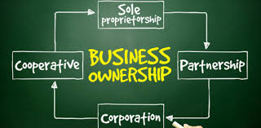
Forms of Business Ownership

Slide 2

I will be able to explain the different forms of business ownership a business can take.

Slide 3

One of the most important decisions entrepreneurs make when starting a new business is the form of ownership they will use
A business can operate under the name of its owner or it can do business under a fictitious name, such as Rafie’s coffeeshop

Slide 4
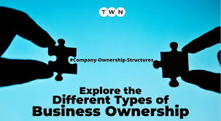

Why Is Ownership Type important?
In the world of business, forms of ownership define:
Initial cost of setting up the business
How profits are distributed
Types of regulations it must follow
Division of Profits, and who pays debts
The types of taxes (if any) the business must pay

Slide 5
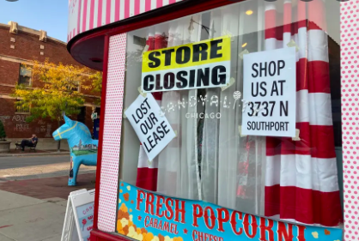
Finally, choosing the right form of ownership helps entrepreneurs battle the odds against survival
80% of new businesses close withing 5 years!

Slide 6
Terms to Understand
Liability is a debt or responsibility that someone owes to another person or entity
Capital - the total amount of money, property, or other assets that a person or institution owns

Slide 7
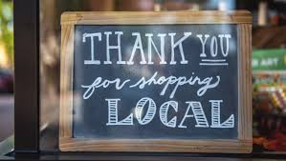
Businesses Can be Small or Large
Small Businesses < 500 Employees
Large Businesses > 500 Employees
What percent of Businesses are small businesses?
  According to the Small Business Administration (SBA), 99.9% of businesses in the United States are small businesses. This means that as of 2023, there were 33,185,550 small businesses in the U.S.

Slide 8


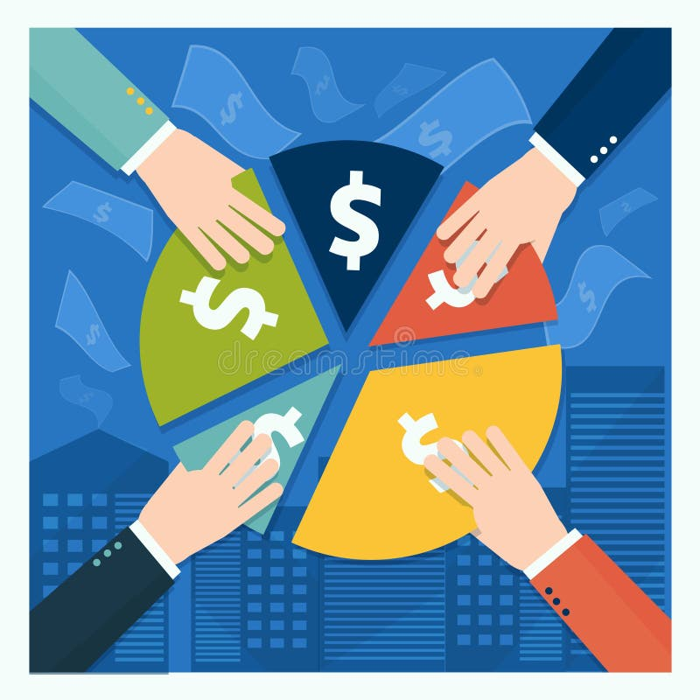

The majority of businesses in the U.S. are owned and organized under one of three forms of business ownership:
Sole Proprietorship
Partnership
Corporation

Slide 9
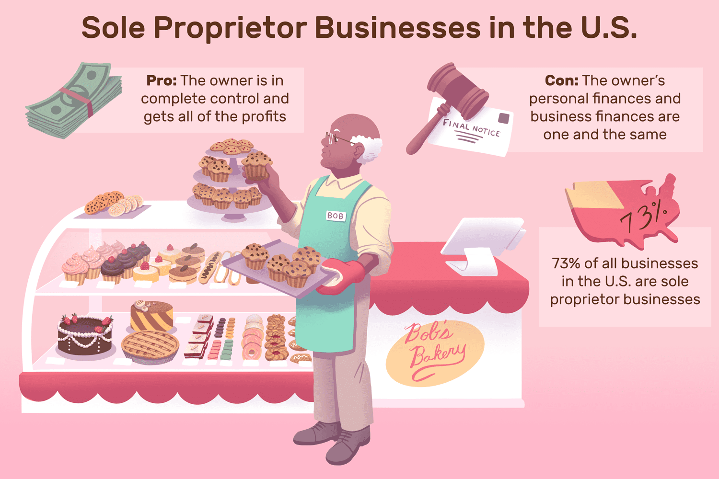
What is a Sole Proprietorship?
Sole Proprietorship: a business owned and operated by a single individual
A sole proprietor is simply an extension of the owner, as far as the law is concerned. Sole proprietorships have
- One Owner
- One person with complete control and decision making
- One person gets all the profit
- One person personally responsible for all business activities including any debt owed

Slide 10
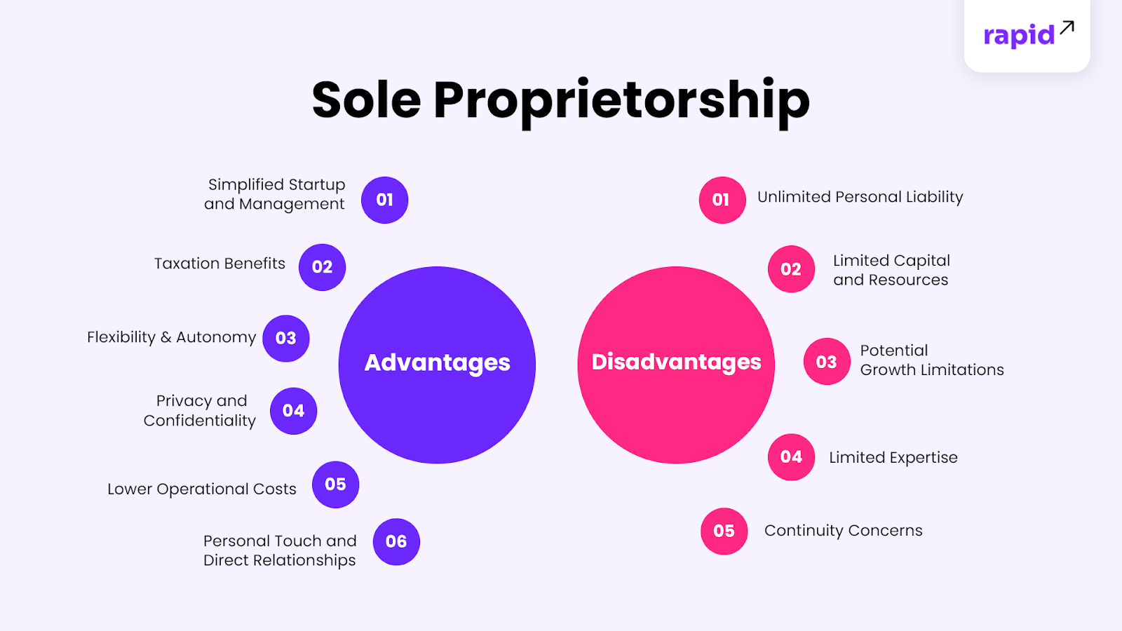

Slide 11
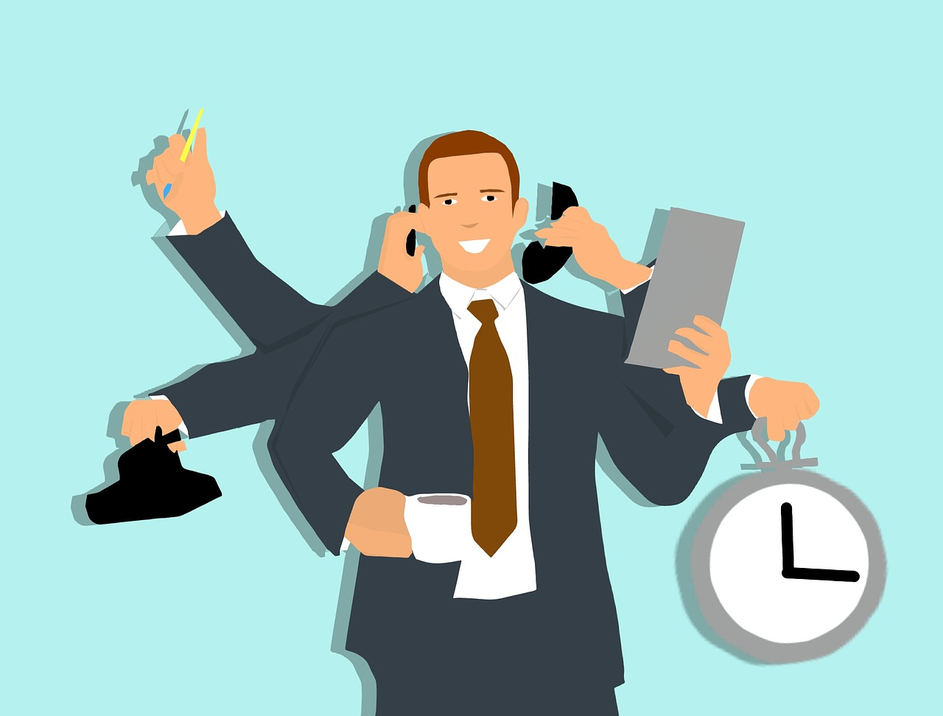
Sole proprietorships are popular because:
they are easy to form and operate
They are the cheapest to operate, as there are usually no fees to form the business
Tax benefits such as pass-through taxation, in which the profits of the business are only taxed on the owner’s personal income tax return
However, a drawback of sole proprietorships is the unlimited liability, meaning that owners can be personally liable for any debts of the business

Slide 12
What is a Partnership?
Partnership: a business with two or more owners
Partners share in both the operation of the business, profits, and the financial responsibility for its debts
Can be a 50/50 split or other defined by the owners

Slide 13
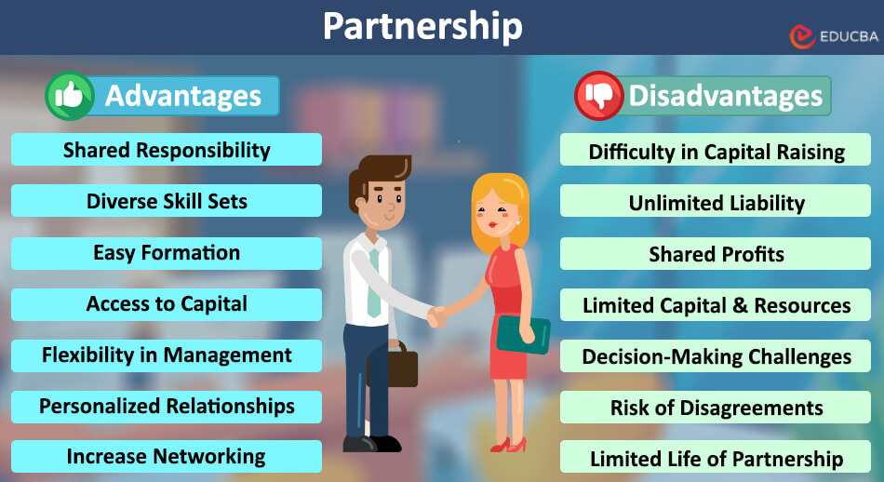

Slide 14
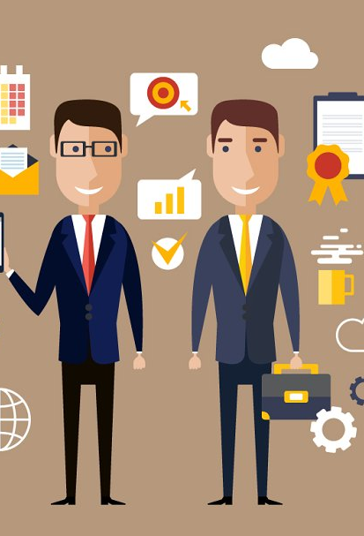
Partnerships are a popular Because
Individuals combine their skills and ideas to jointly operate a business
Both share the capital (money) to invest and start the business
Allow the business to grow by adding new talent and new money.
Enjoy tax benefits such as pass through taxation
A major drawback of partnerships is unlimited liability – however it is shared. (i.e. if owe $1000 each partner splits the cost)

Slide 15

What is a Corporation?
Corporation: a legally established business with many owners that can enter into contracts, own assets and incur debt, and sell products but is completely separate from its owners, known as shareholders

Slide 16
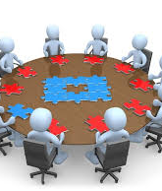

Corporations Advantages
It can legally engage in virtually any business activity a natural person can pursue
Owners are stockholders – how they raise money and fund the business
Easy transfer of ownership
Better access to capital (through selling stocks)
Limited personal liability – only the amount you invested in stock

Slide 17
Corporation Disadvantages
Very Expensive to organize
Government Regulation set forth that corporations must follow
Founders may lose control of corporation
Requires more time and money
Double Taxation
  Corporations usually pay income tax on their earnings
  Stockholder's pay income tax on their dividends and increased value of their stock when they sell it.

Slide 18

One of the biggest benefits of corporations is their limited liability
Limited Liability: owners are not personally liable for claims against their business
Owners with limited liability may lose their investment in the company, but their other personal assets are protected

Slide 19

Drawbacks:
However, corporations are complex and expensive to form
Corporations are required to send out annual statements to all shareholders
Hold regular meetings with their board of directors

Slide 20

Quick Write Activity
In your Activity Packet
If you were to start your own business today, which form of business ownership would you choose, and why?

Slide 21
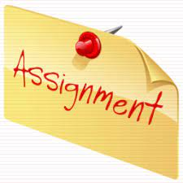
Activity:
Go to Google Classroom and complete the Quizzes on the Types of Business Ownership

Slide 22

Activity: Business Ownership Scenarios
Directions: For each of the following companies, use the provided information to determine if its form of business ownership is a sole proprietorship, partnership, or corporation.

Slide 23
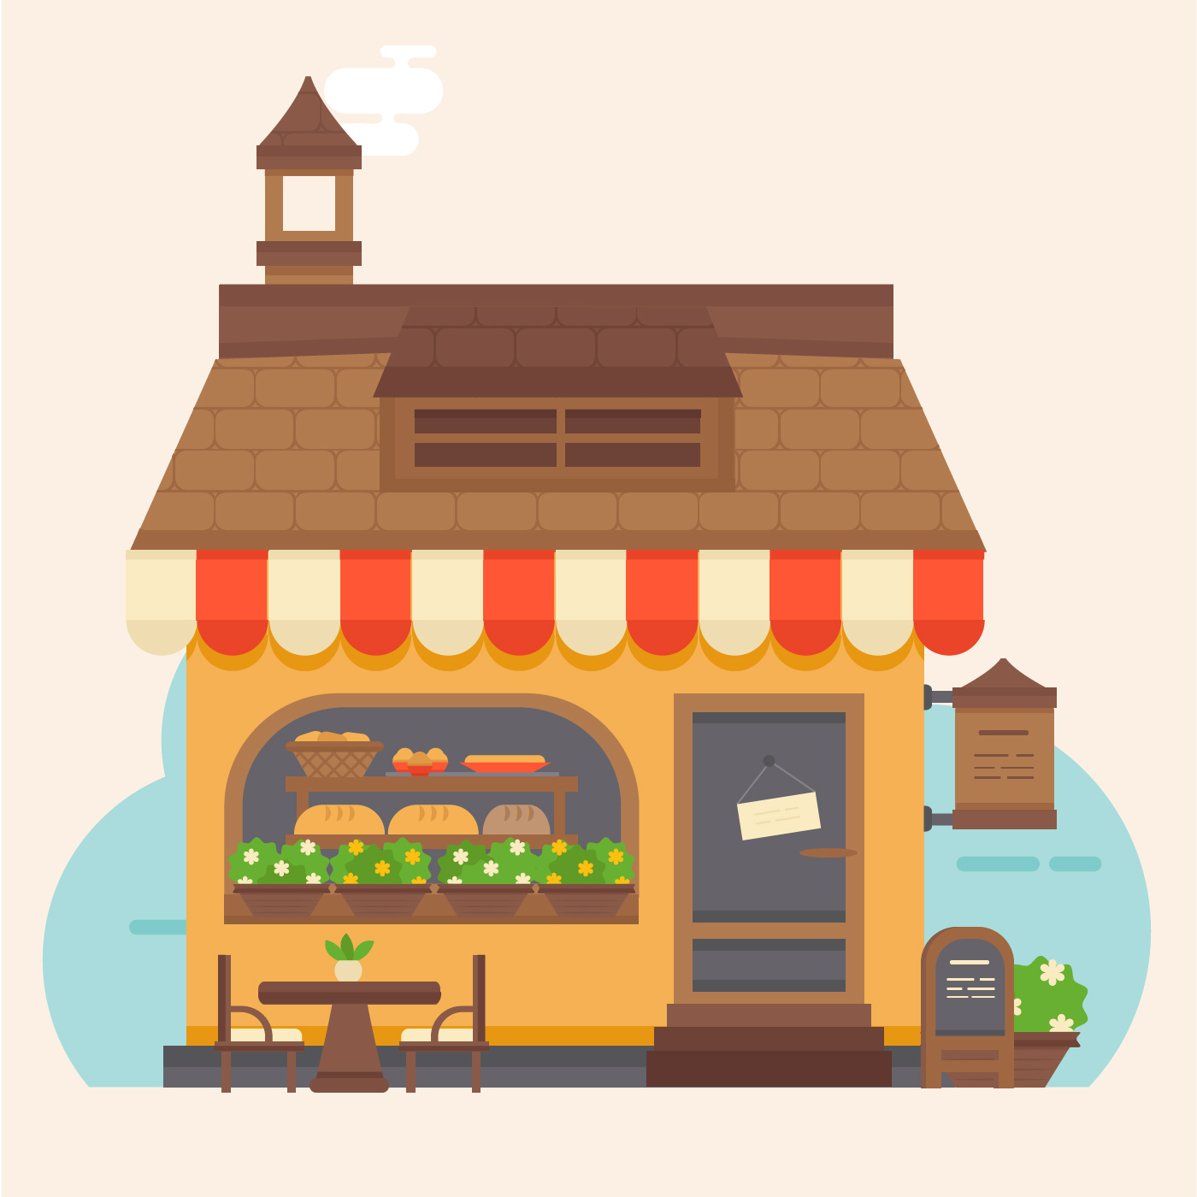
1. Sweet Delights Bakery
Sweet Delights Bakery is a locally-owned bakery known for its mouthwatering assortment of freshly baked goods, including cakes, pastries, and cookies. The business was founded by Emily, who handles all aspects, from baking to customer service, to ensure the highest quality for her customers.

Slide 24

2. Artistic Expressions
Artistic Expressions is an art gallery and studio, offering a space for local artists to showcase their artwork. It also hosts art classes and workshops, encouraging aspiring artists to explore their creativity. Paul and Pedro passionately run the operations of the studio, but are frustrated that any profits are subject to double taxation.

Slide 25

3. Green Thumb Landscapes
Green Thumb Landscapes is a renowned landscaping company that designs and maintains outdoor spaces for residential and commercial clients. The founders and owners share responsibilities and decision-making, as well as the profits and losses. They are landscape architects committed to implementing sustainable and eco-friendly practices.

Slide 26
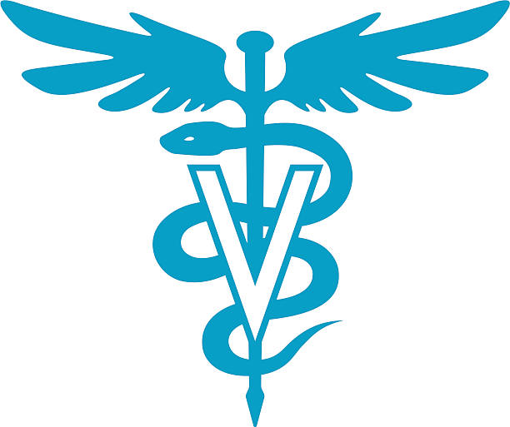
4. Pet Pals Veterinary Clinic
Pet Pals Veterinary Clinic is a well-established and busy veterinary clinic with multiple locations. Founded by Dr. Lisa, Dr. Sam, and Dr. Michael, experienced veterinarians, the clinic is known for providing exceptional medical care to pets. All business decisions, such as purchases for new equipment for the clinic, are handled by a board of directors.

Slide 27
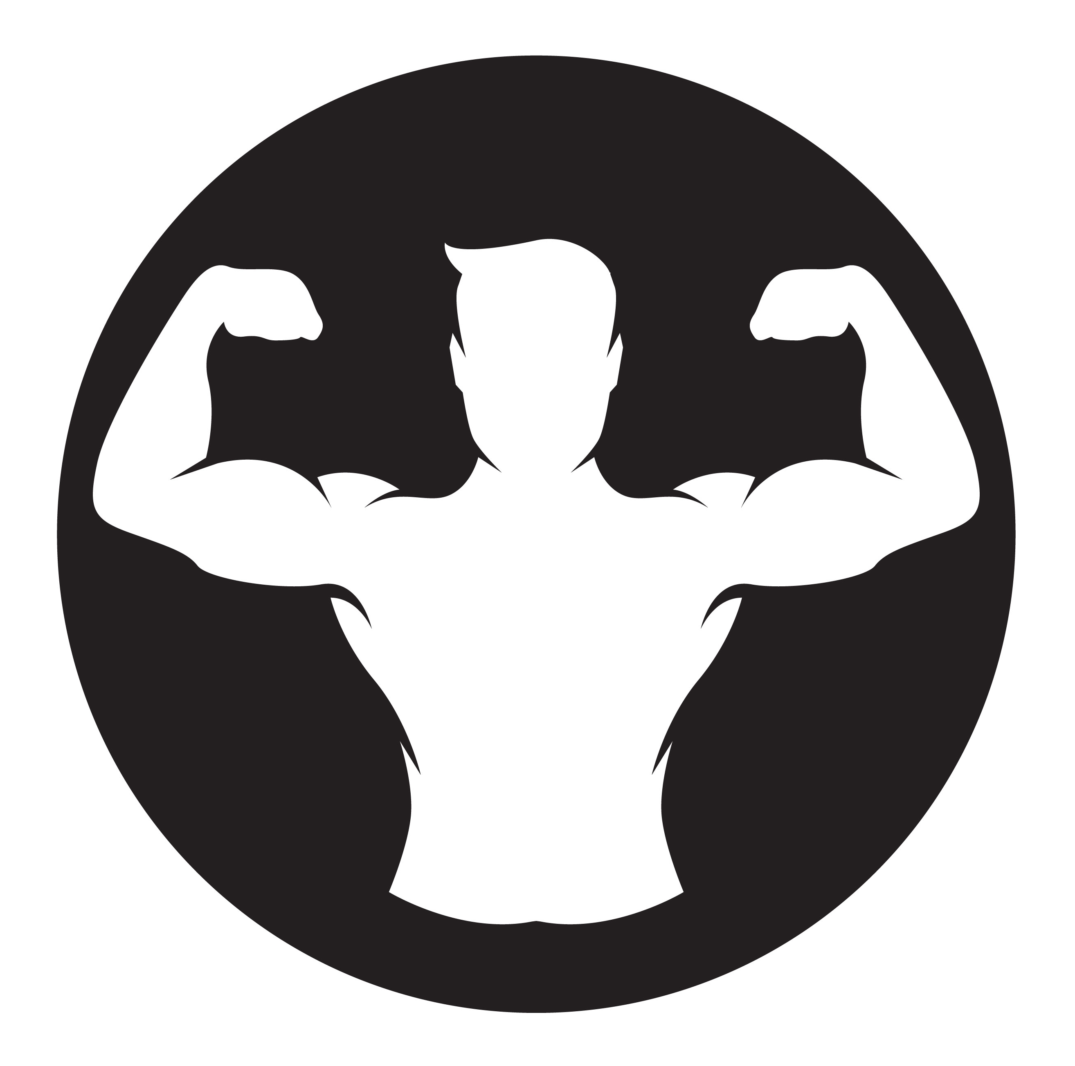
5. Fit Zone Gym
Fit Zone Gym is a large fitness center offering a wide range of workout equipment, personal training services, and group fitness classes. The gym is ran by a Marta, who started her fitness career as a personal trainer herself. Marta has chosen not to withdraw any profits, and has been able to grow the gym by reinvesting any earnings in the gym instead.

Slide 28
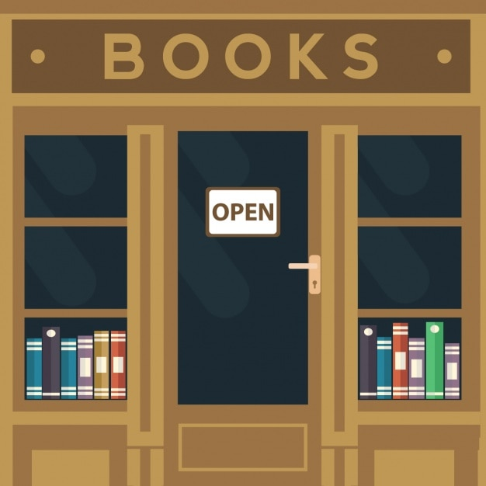
6. Cozy Corner Bookstore
Cozy Corner Bookstore is a beloved bookstore with an extensive collection of books catering to various interests. Emma, the passionate manager, provides personalized recommendations and fosters a warm atmosphere for book lovers. In order to raise money to purchase additional locations, the business decides to issue additional shares of stock.

Slide 29
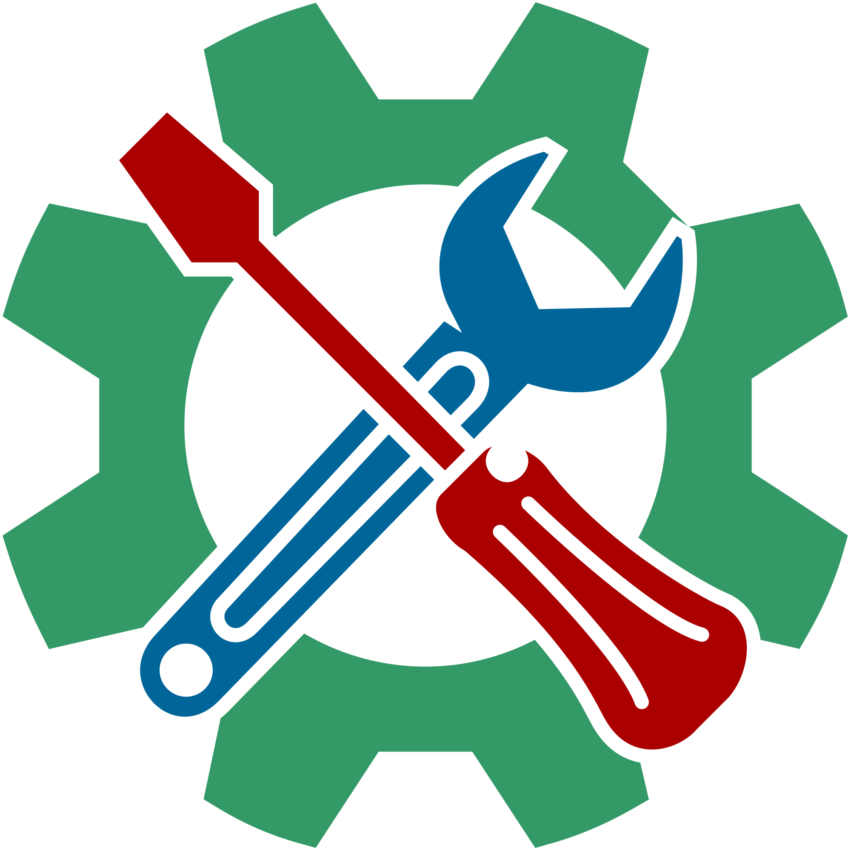
7. Tech Savvy Solutions
Tech Savvy Solutions is a technology consulting firm that offers innovative IT solutions to businesses. Founded by seven tech enthusiasts, the firm boasts a team of skilled professionals specializing in network optimization, software development, and cloud-based solutions. However, some of the owners worry about being personal liable for any loans the company is unable to pay back.

Slide 30

8. Green Tech Innovations
Green Tech Innovations is a forward-thinking technology company focused on developing sustainable products to reduce environmental impact. The company is committed to its mission of creating innovative solutions for a greener world. The shareholders enjoy the limited liability provided to them, as well as the ability to easily raise additional funds.

Slide 31
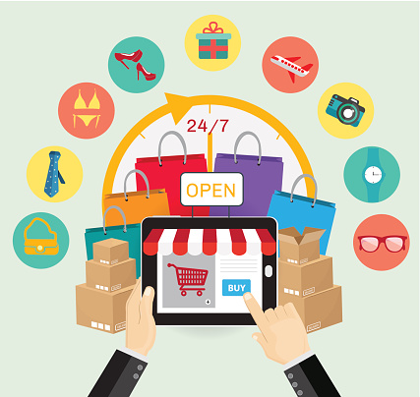
9. Savvy Shoppers Online Marketplace
Savvy Shoppers is a popular online marketplace where sellers from various regions can list and sell their products. The platform is run by Jan, who enjoys the freedom to make any decisions, but is concerned about being personally responsible for any business obligations.

Slide 32
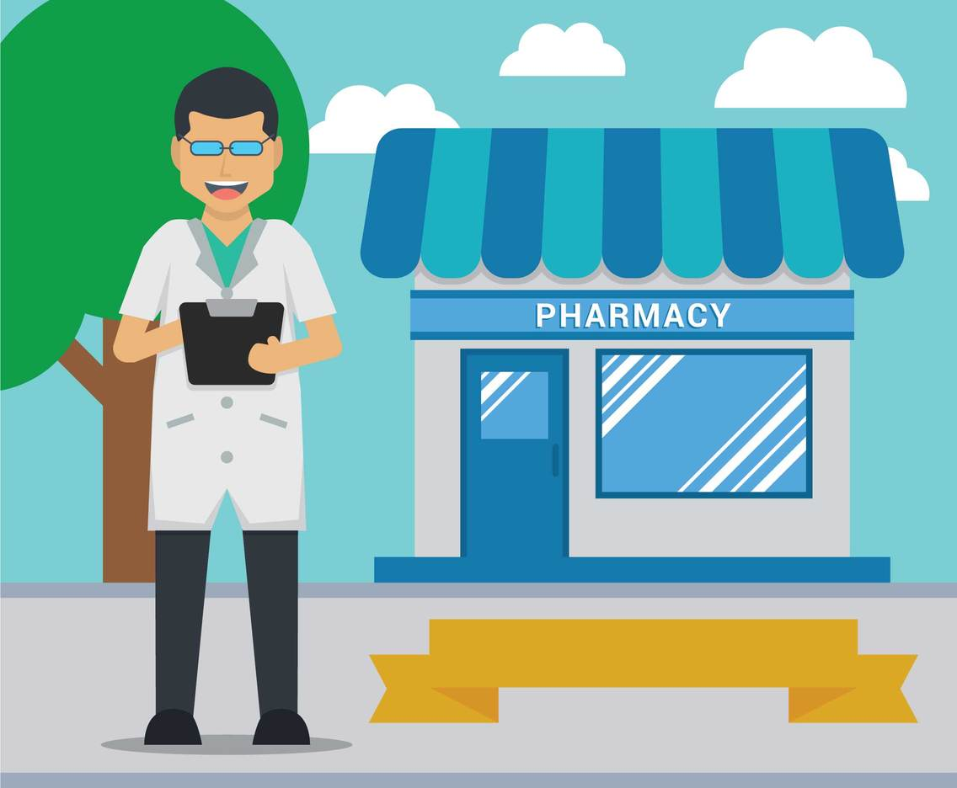
10. Health First Pharmacy
Health First Pharmacy is a reputable community pharmacy providing personalized medication services and health consultations. The pharmacy has multiple branches nationwide, and holds regular board of director meetings.

Slide 33
Business Ownership Scenarios – Answer Key
Sole Proprietorship
Corporations
Partnership
Corporation
Sole Proprietorship
Corporation
Partnership
Corporation
Sole Proprietorship
Corporation

Slide 34
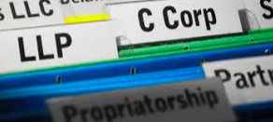
Summary
Explain which form of business ownership you believe would be most suitable for a new tech startup and why.

